Slide 1

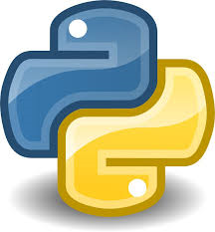





LIST & DICTIONARY
Some powerful tools of python

Slide 2


AAKANSHA JAIN
BTech(IT) IInd yr
Banasthali University
MERN Developer | ML Enthusiast |Data Analyst | Blogger

Slide 3
If failed==True:
keepGoing()
neverGiveUp()
else:
celebrateHowAwesomeYouAre()
neverStopCoding()
# Never Stop Improving

Slide 4


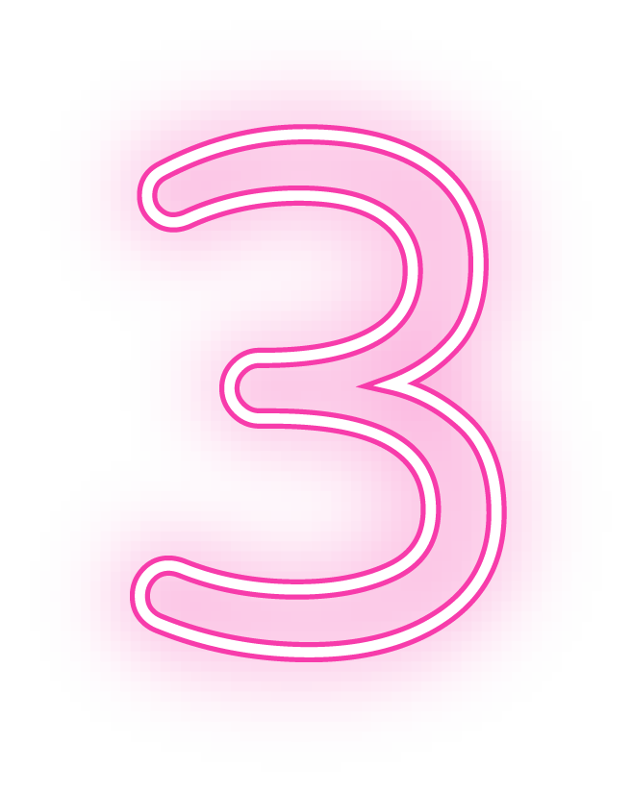
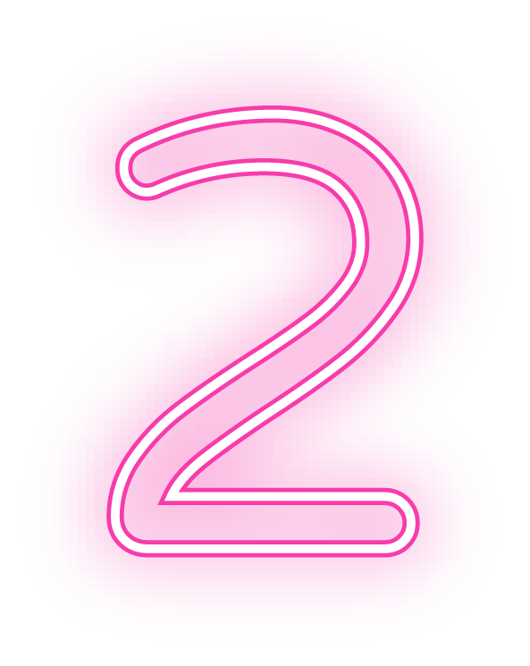
LIST
LIST VS DICTIONARY
TABLE OF CONTENTS
DICTIONARY

Slide 5
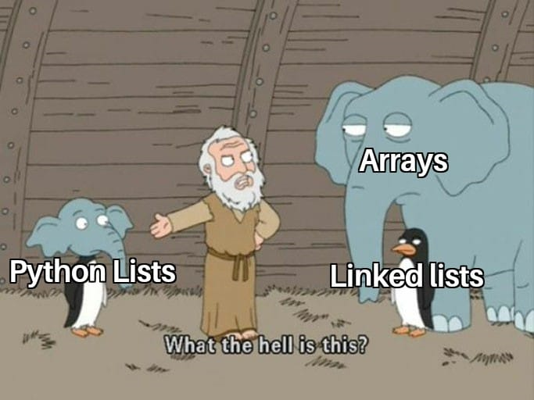
01
LIST
Let’s get started with Lists

Slide 6
WHAT IS A LIST?
Data structure in Python.
Like dynamic sized arrays.
Can contain heterogeneous data types.
Mutable.

Slide 7

LET’S CODE IT

Slide 8
02
DICTIONARY

Slide 9

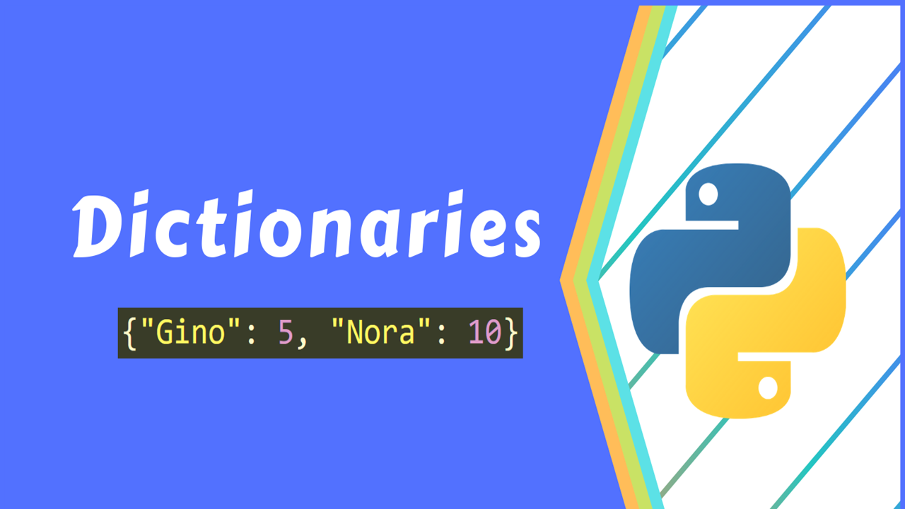


Slide 10
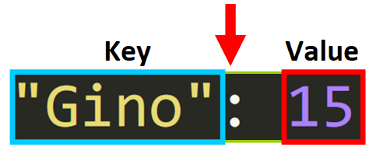
Dictionaries are a way to store information that is connected in some way.
It contains an unorganized collection of data values ( for example, a map).
Dictionaries store information in key-value pairs

Slide 11
03
LISTS VS DICTIONARY

Slide 12
LISTS VS DICTIONARIES
COMMON
DIFFERENCES
They are mutable.
They are dynamic
They can be nested.
List can be accessed through index positions.
Dictionary elements are accessed through keys.

Slide 13
The “Anatomy” of a Python Dictionary
Since a dictionary “connects” two values, it has two types of elements:
Keys: a key is a value that is equivalent of “indices”.
Values: these are the values that you can access with their corresponding key.

Slide 14
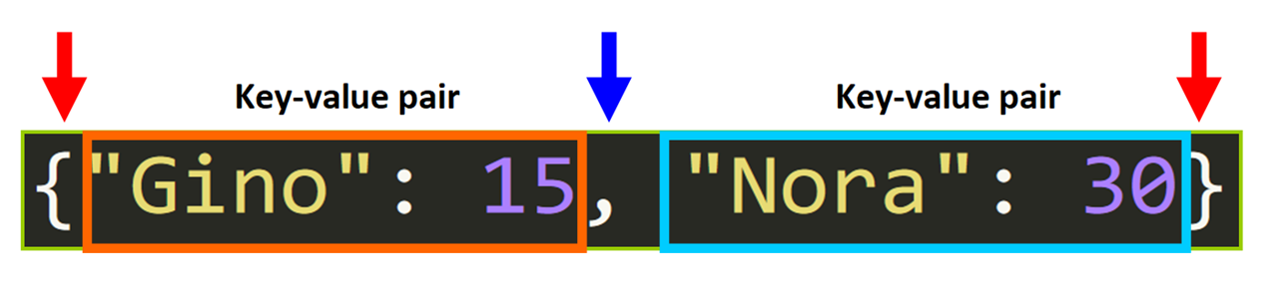
SYNTAX

Slide 15




CONNECT WITH ME:
aakansha-jain99
Aakansha99
@jain_aakansha99
@jainaakansha28

Slide 16

THANKS

